Slide 1
gideon@thecopycourse
writing content & design
www.thecopycourse.com
@gideontodes
28 Lady Somerset Road
London NW5 1UP
gideon@thecopycourse
Writing content & design
www.thecopycourse.com
Follow and skype @gideontodes
28 Lady Somerset Road London NW5 1UP
Discourse Analysis for Sovereign Competition and Stakeholders
DASCOMPS part 1
For Megan Aubrey, Sovereign

Slide 2
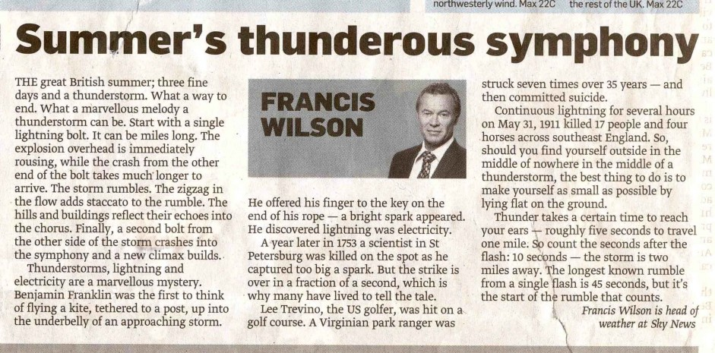

Slide 3
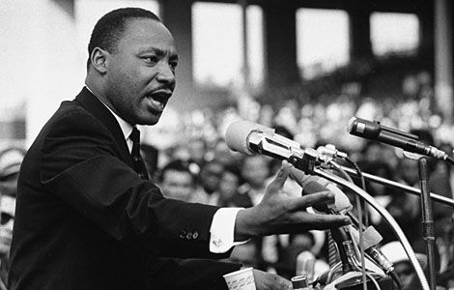
Abridged text of Dr. Martin Luther King, Jr.’s
“I Have a Dream” Speech
Aug. 28, 1963
Five score years ago, a great American, Abraham Lincoln, in whose symbolic shadow we stand today, signed the Emancipation Proclamation.
But one hundred years later, the negro is still not free.
One hundred years later, the life of the negro is still sadly crippled by segregation and discrimination.
Now is the time to make real the promise of democracy.
We can never be satisfied as long as our children are stripped of their selfhood and robbed of their dignity by signs stating “for white only”.
We cannot be satisfied as long as a negro in Mississippi cannot vote and a negro in New York believes he has nothing for which to vote.
I have a dream that my four little children will one day live in a nation where they will not be judged by the color of their skin but by the content of their character.
I have a dream that one day right down in Alabama little black boys and black girls will be able to join hands with little white boys and white girls as sisters and brothers.
We will be able to work together, to pray together, to struggle together, to go to jail together. And if America is to be a great nation, this must become true.
And when this happens, we will be able to speed up that day when all of God’s children, black men and white men, Jews and Gentiles, Protestants and Catholics, will be able to join hands.
And be free at last.

Slide 4
1.
We have a place, all of us, in a long story—a story we continue, but whose end we will not see. It is the story of a new world that became a friend and liberator of the old, a story of a slave-holding society that became a servant of freedom, the story of a power that went into the world to protect but not possess, to defend but not to conquer. It is the American story—a story of flawed and fallible people, united across the generations by grand and enduring ideals. The grandest of these ideals is an unfolding American promise that everyone belongs, that everyone deserves a chance, that no insignificant person was ever born. Americans are called to enact this promise in our lives and in our laws. And though our nation has sometimes halted, and sometimes delayed, we must follow no other course. Through much of the last century, America’s faith in freedom and democracy was a rock in a raging sea. Now it is a seed upon the wind, taking root in many nations. Our democratic faith is more than the creed of our country, it is the inborn hope of our humanity, an ideal we carry but do not own, a trust we bear and pass along. And even after nearly 225 years, we have a long way yet to travel. While many of our citizens prosper, others doubt the promise, even the justice, of our own country. The ambitions of some Americans are limited by failing schools and hidden prejudice and the circumstances of their birth. And sometimes our differences run so deep, it seems we share a continent, but not a country. We do not accept this, and we will not allow it. Our unity, our union, is the serious work of leaders and citizens in every generation.

Slide 5
2.
That we are in the midst of crisis is now well understood. Our nation is at war against a far-reaching network of violence and hatred. Our economy is badly weakened, a consequence of greed and irresponsibility on the part of some, but also our collective failure to make hard choices and prepare the nation for a new age. Homes have been lost, jobs shed, businesses shuttered. Our health care is too costly, our schools fail too many — and each day brings further evidence that the ways we use energy strengthen our adversaries and threaten our planet. These are the indicators of crisis, subject to data and statistics. Less measurable, but no less profound, is a sapping of confidence across our land; a nagging fear that America’s decline is inevitable, that the next generation must lower its sights. Today I say to you that the challenges we face are real. They are serious and they are many. They will not be met easily or in a short span of time. But know this America: They will be met.

Slide 6
